Slide 1

“Integrating learning and teaching research, evaluation, and practice to create NTU education environment”
Peter Looker
Head
Teaching, Learning and Pedagogy
Division, NTU
12 January, 2018

Slide 2

“I never teach my pupils, I only attempt to provide the conditions in which they can learn.” Albert Einstein

Slide 3
University as a learning institution
Systematic problem solving
Experimentation with new approaches
Learning from experience learning from the experiences and practices of others
Transferring knowledge quickly and efficiently throughout the organization
D’Andrea V. and Gosling D. (2005) Improving Teaching and Learning in Higher Education: a whole institution approach Society for Research in Higher Education and Open University Press p.51

Slide 4

Blue Ribbon Commission on Undergraduate Education
15 March, 2011
IT-related environment
Classrooms of tomorrow
‘Retooling’ the teaching staff

Slide 5
Pedagogy/
content
technology
space
Blended learning requires the blending of three areas of expertise: pedagogical expertise, technological design expertise, and subject expertise. But institutions often treat these independently, and divide responsibility for them into different roles. (M.Koehler et al, 2004)

Slide 6
Integrated learning environment
faculty training in learning and teaching
research
and evaluation
of learning
and
teaching
educational
technology
Student
Learning
physical
environment
varied pedagogies
Principles,
Policies,
Procedures
What are the key components of a structure that supports a good student learning environment?

Slide 7
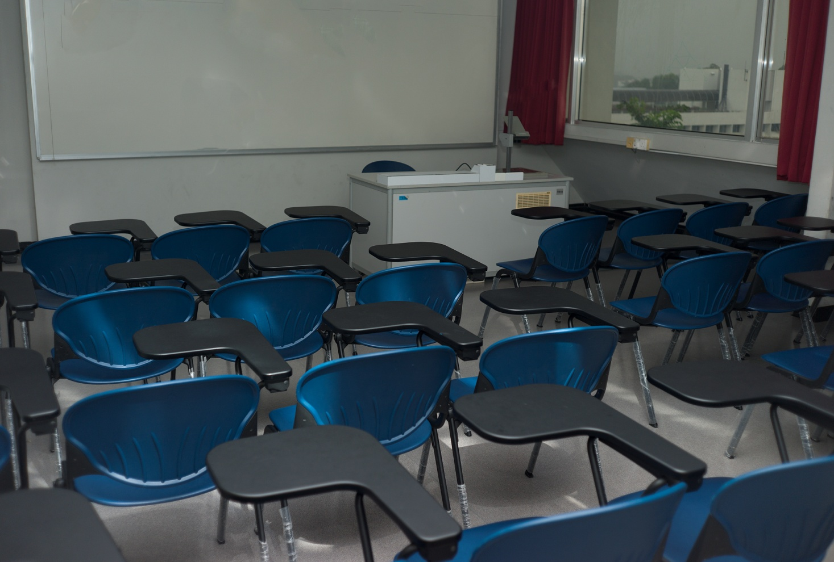
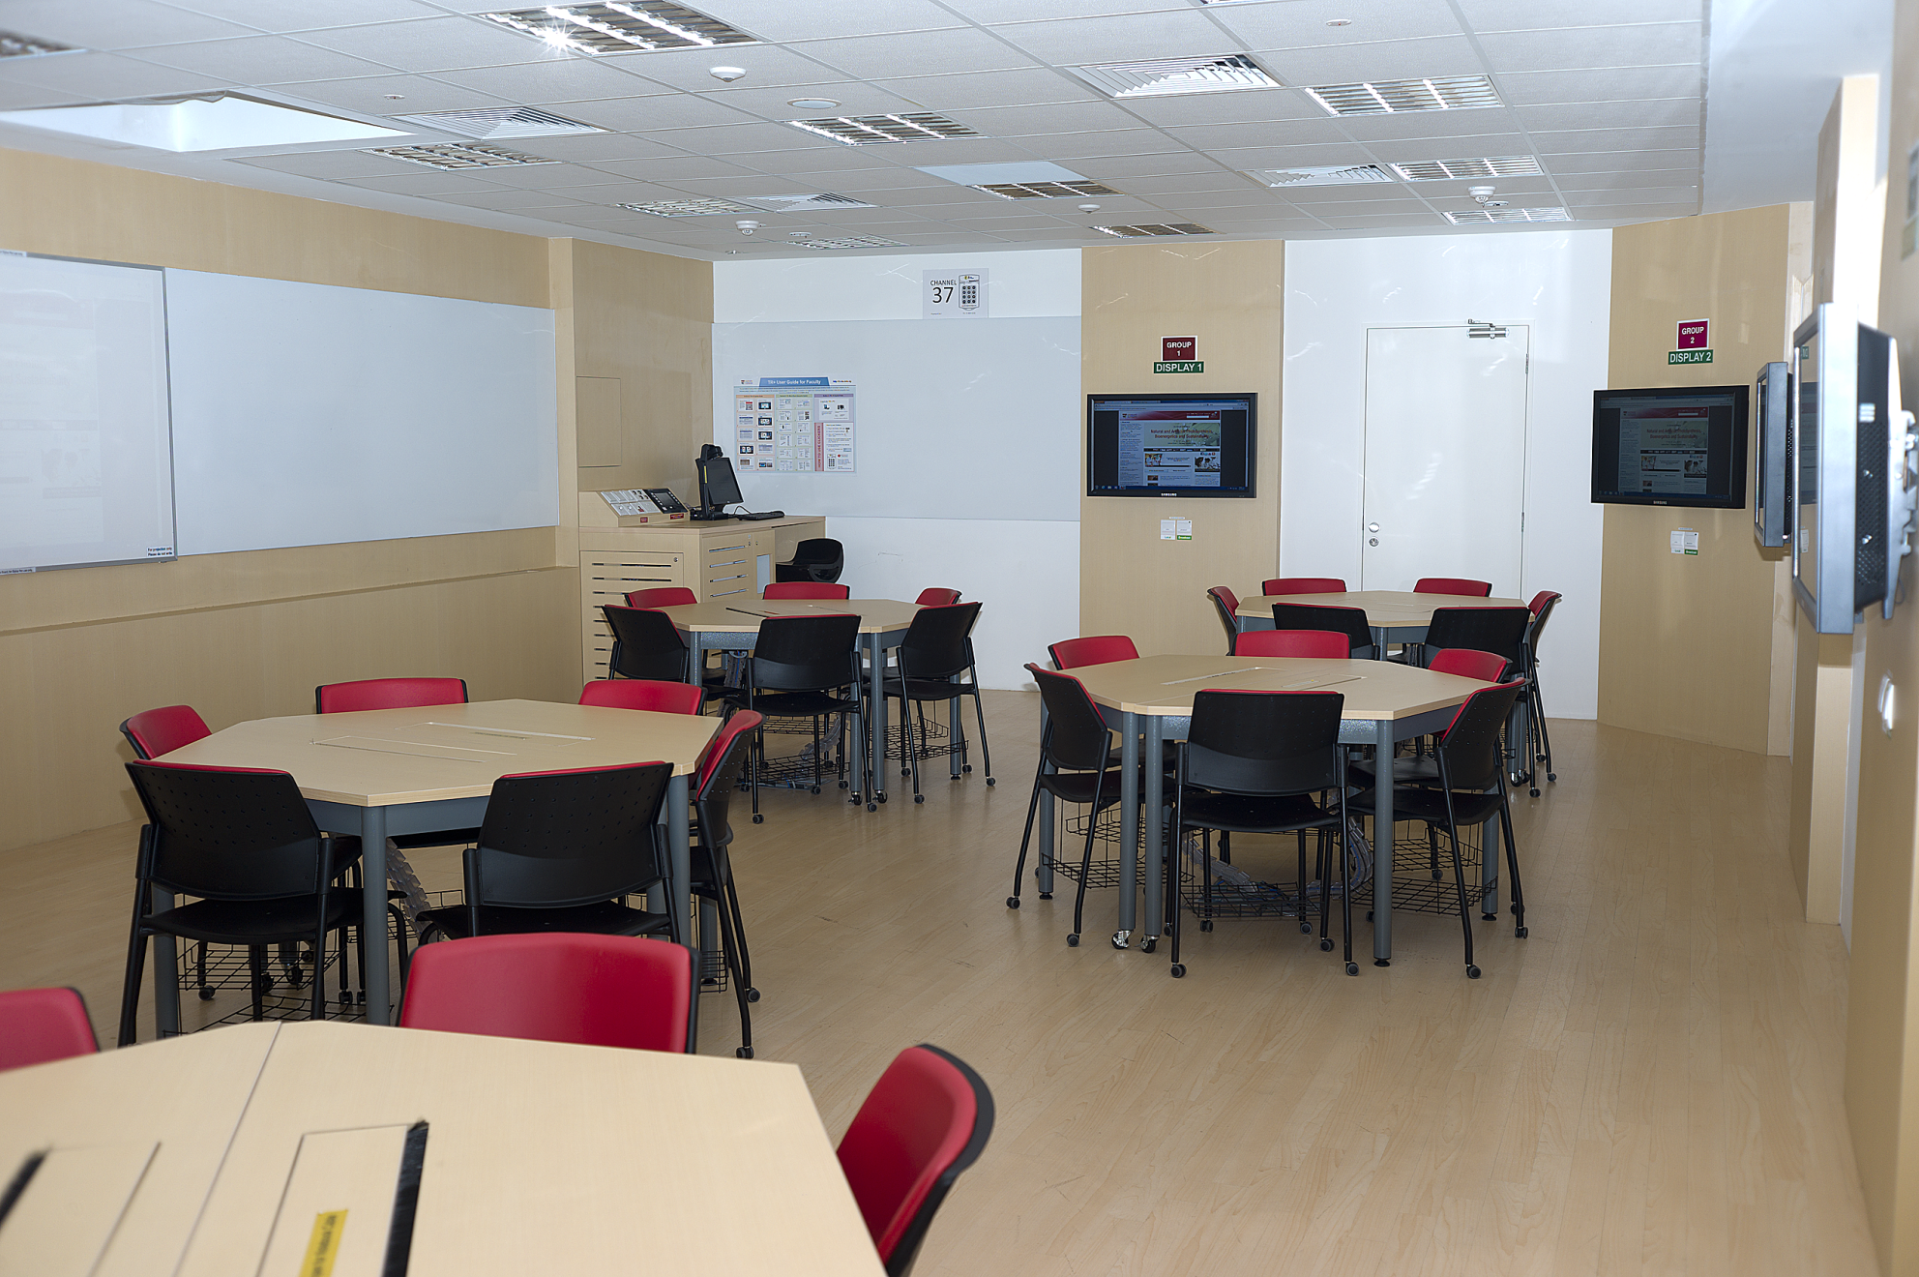
physical environment

Slide 8
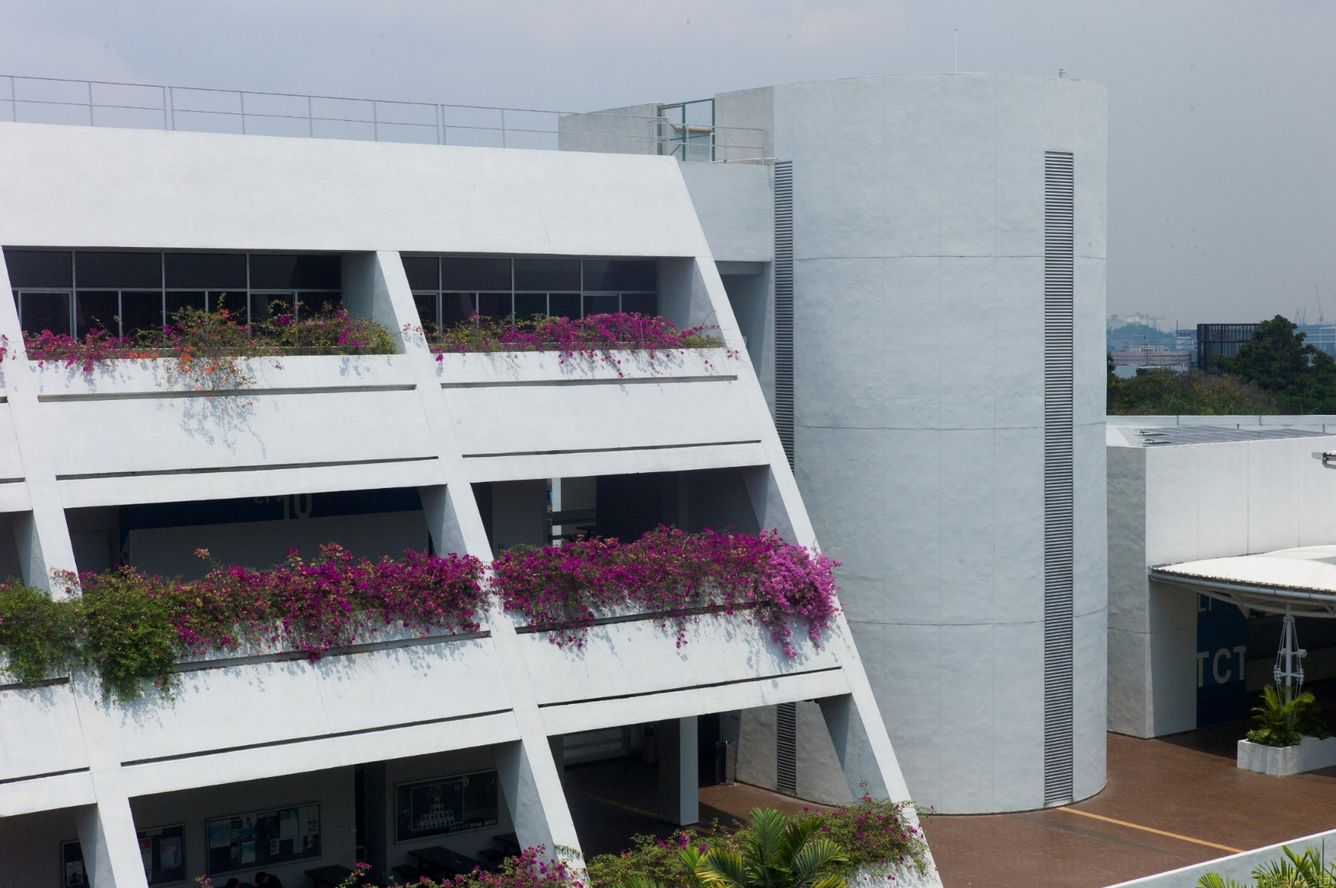
physical environment
Year | Phase | No of Rooms
2010 | Experimental phase | 3 TRx Rooms
2011 (April to July) | Phase 1 | 43 TR+ Rooms
2011 (Dec) | Phase 1A | 2 TR+ Rooms
2012 (April to July) | Phase 2 | 40 TR+ Rooms
2016 (April to July) | Phase 3 | 20 TR+ Rooms
_{Total of 108 rooms converted}

Slide 9
physical environment
Desirable features of learning spaces
Maximize ability for student-student collaboration and student-teacher interaction
Enable student work to be “visible”
Enable networked learning within the classroom and reaching outside classroom

Slide 10
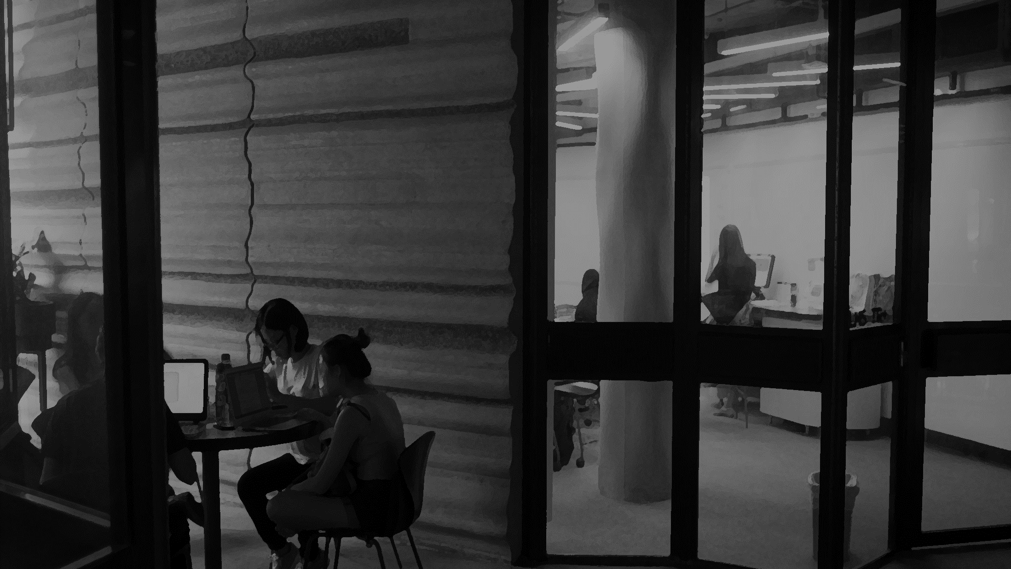
Preliminary study of NTU informal
learning spaces
“course-related activity undertaken individually
and collaboratively on campus that occurs outside the classroom”
Jamieson, P. (2009) “The serious matter of informal learning” Planning for Higher Education 37(2) 18-24

Slide 11
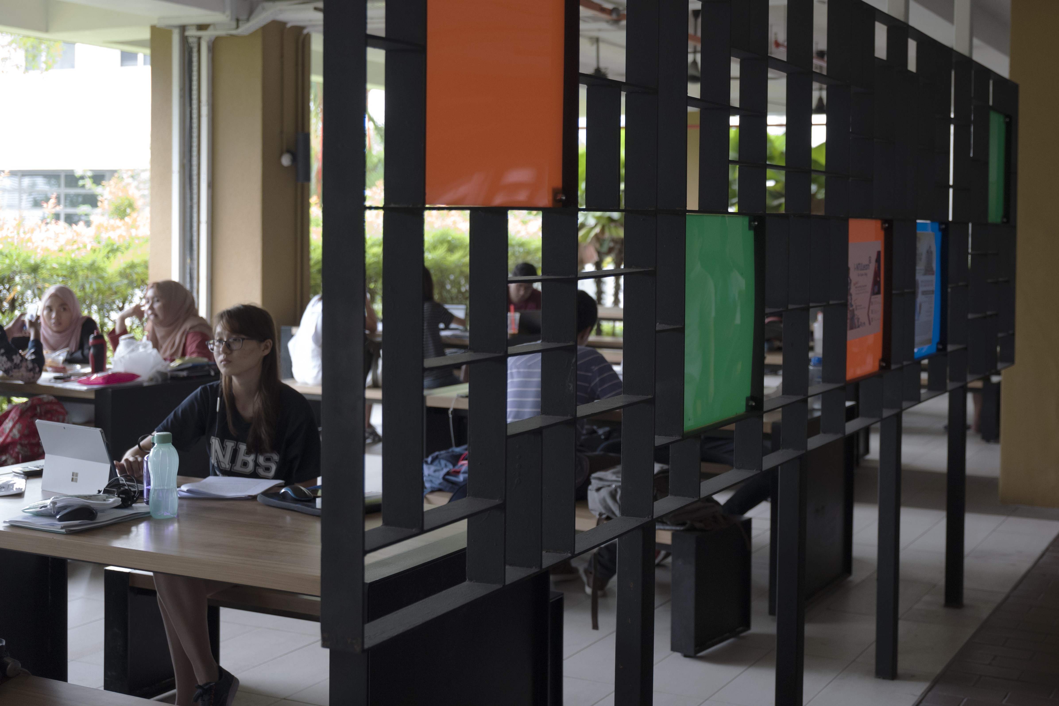
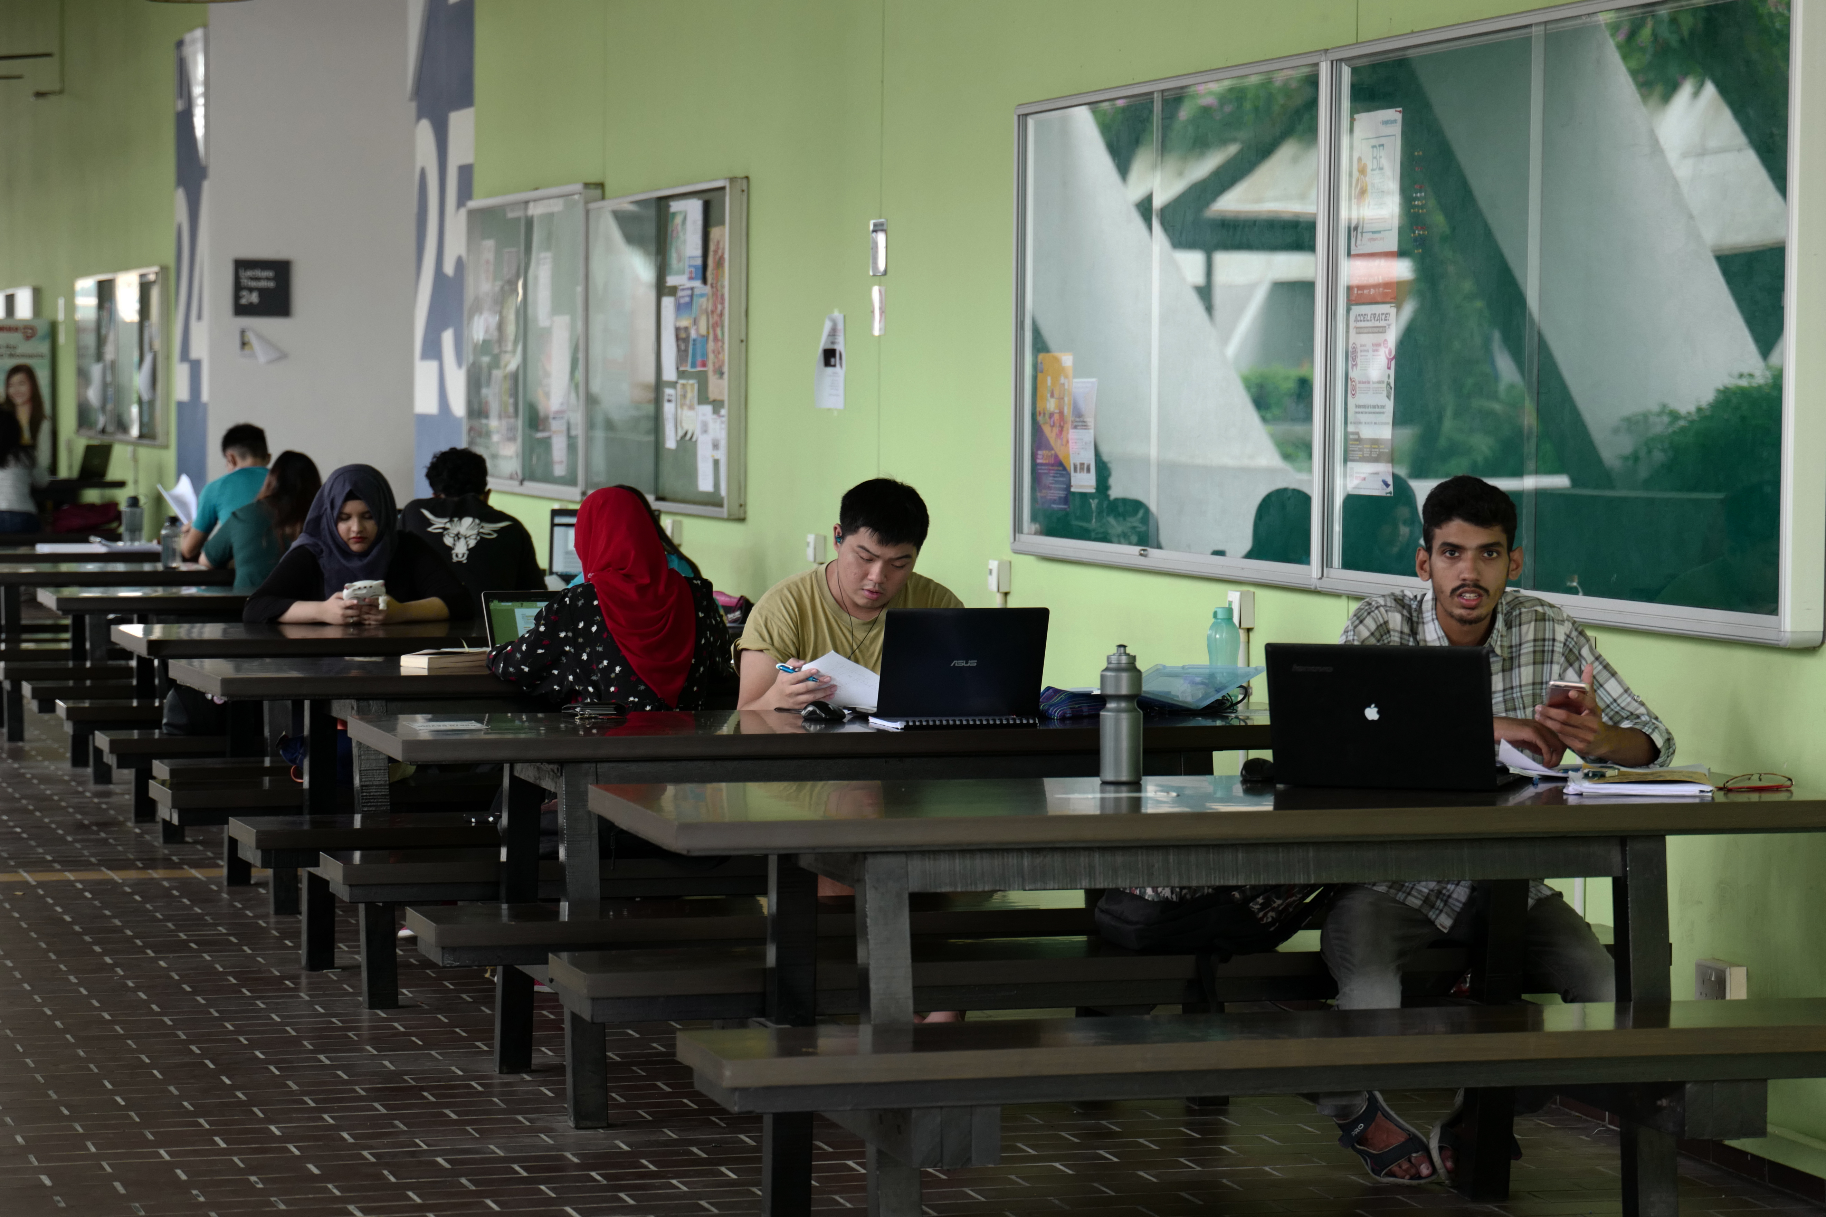
Mapping informal spaces
“Coloured glass”
Outside lecture theatre

Slide 12
Research questions
Where and how are the informal spaces being used in NTU?
What are the students’ attitudes and preference for informal learning spaces?
What are the features of the informal learning environment that students find important in supporting their learning activities outside class?

Slide 13
Factors affecting satisfaction
Respondents were asked to rate 2 questions (expectation and actual) with 11 sub-questions (factors) on a 4 point scale (Strongly disagree to Strongly agree)
Questions were developed from a combination of an existing survey instrument and open-ended coding from the pilot survey
Factors measured include:-
Furniture (e.g., movable furniture, table size, seat comfort)
Air circulation
Lighting
Cleanliness
Facilities (WiFi, power points)
Eating is allowed
Able to have discussion
Proximity to class
Privacy
Regularly scheduled meetings

Slide 14
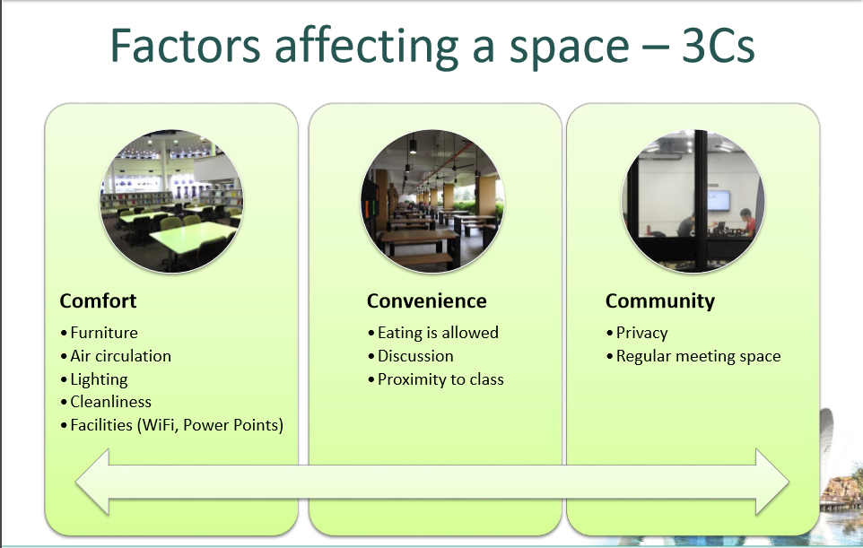

Slide 15
Convenience vs. Community
Community
Low Convenience, High Community
Space allows for group discussion / meetings
Not necessarily close to class or tutorial venues
High Convenience, High Community
Close to lecture or tutorial rooms
Discussion occurs freely within the spaces
Space used by students to take a break from their routine
Convenience
Low Convenience, Low Community
Not necessarily close to class or tutorial venues
Talking and discussion is not allowed
Convenience, Low Community
Close to lecture or tutorial rooms
Space is not used for collaboration or group work

Slide 16
Satisfaction – Convenience vs Community

Slide 17

Tentative conclusion: The Hive is used by students in some of the
ways for which it was designed, as a mixed (formal/informal)
collaborative and social space for learning.
In addition to student satisfaction in terms of community, it is
where students say they come to settle in, staying in The Hive longer
than in other informal learning spaces.

Slide 18

educational technology
http://www.ntu.edu.sg/cits/lsa/LDD/Pages/Our-Showcase.aspx

Slide 19
educational technology
Evaluation of technology-enhanced learning
Initiative
Online survey of students to determine their experience to determine how future design
can meet students’ needs. (Analysis of types of learning environments, rather than by course)
Analysis of assignment scores of assignments done in LAMS to get a sense of effectiveness
of learning
Use of analytics to better understand relationship between students’ online behaviour
And academic performance

Slide 20
faculty training in learning and teaching
To provide faculty and PhD students with a
research-based framework within which to plan and evaluate their own teaching
To create a sufficiently varied environment within which debate about learning and teaching can be part of everyday life at the university

Slide 21
faculty training in learning and teaching
All new junior faculty undertake Foundations of University Learning and Teaching within a year of joining the University.
Course runs twice a year
About 60 participants per year

Slide 22
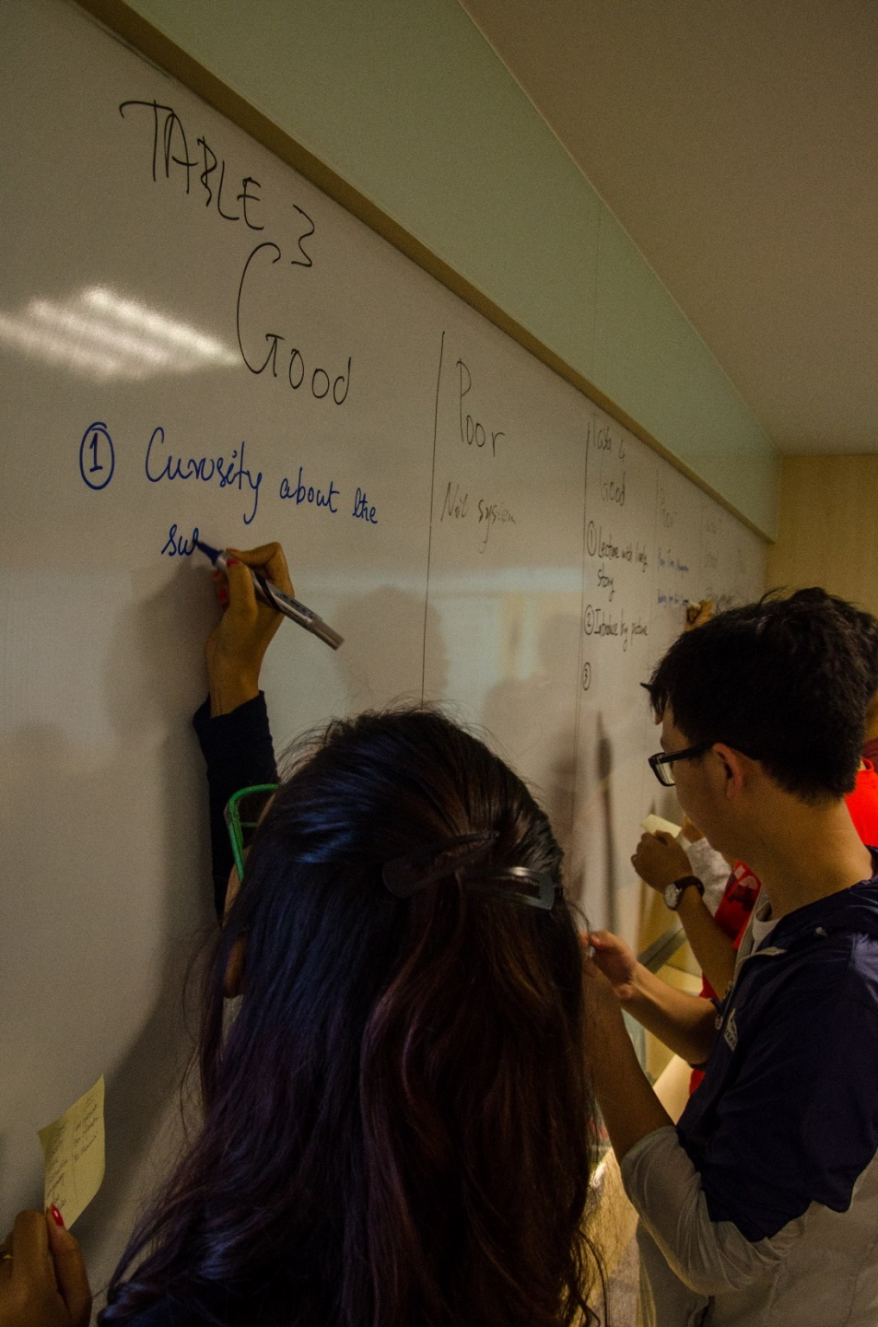
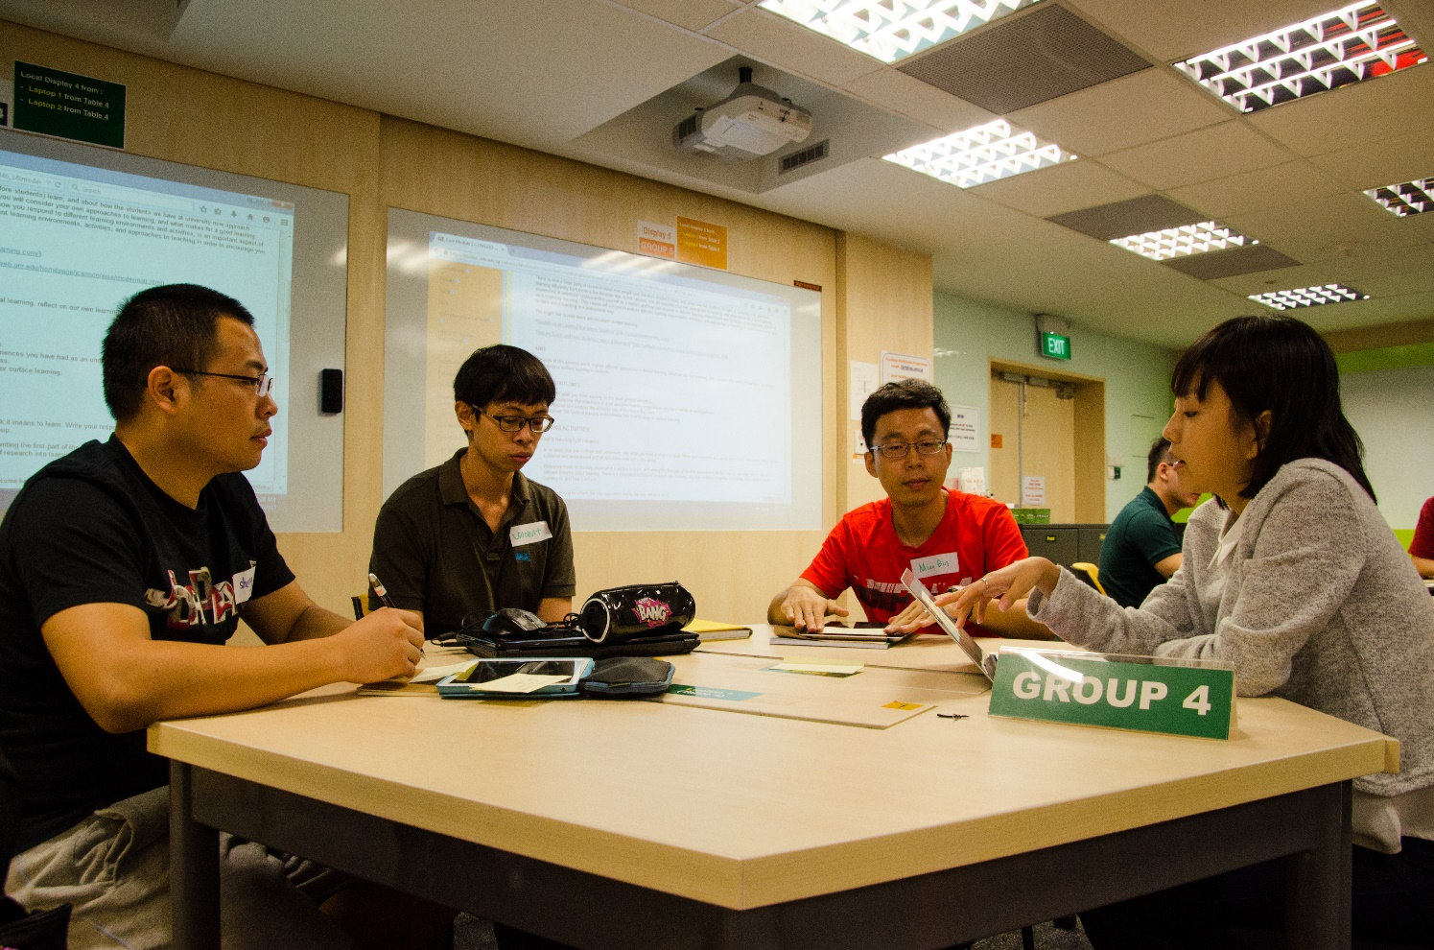
University Teaching for Teaching
Assistants
Semester-long course including assessment
and a micro-teaching evaluation.
Compulsory for all PhD students (about 300 per semester)
faculty training in learning and teaching

Slide 23
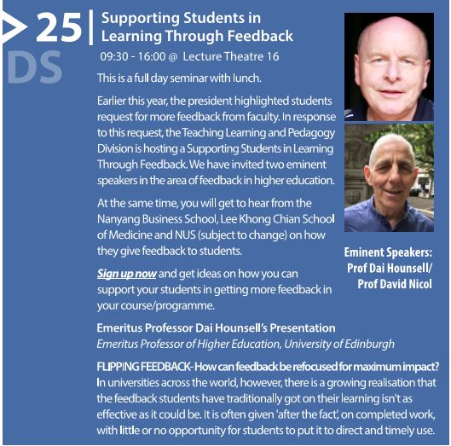

Workshop programme all year – about 80 workshops (TLPD and CITS)

Slide 24

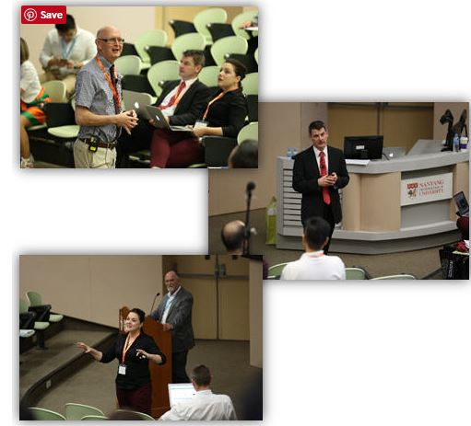

Annual Learning and Teaching Seminar “from Good to Great”

Slide 25

Innovations in teaching focuses on educational technology, social media and NTU case studies

Slide 26
faculty training in learning and teaching
TLPD Distinguished Speaker series: international faculty come to NTU for a week to work with faculty and students in an area of teaching and learning
Each year around 20 faculty are offered individual long-term coaching to develop their teaching capacity

Slide 27
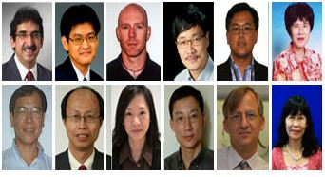
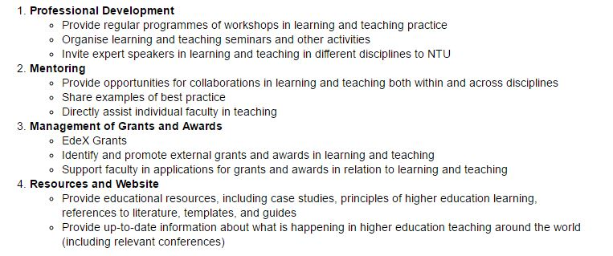

Slide 28
Research
and evaluation of learning and teaching
Centre for Research and Development in Learning (CRADLE)
EdeX teaching and learning grants
Ministry of Education Tertiary research Fund

Slide 29

Centre for Research and Development in Learning (CRADLE)

Slide 30
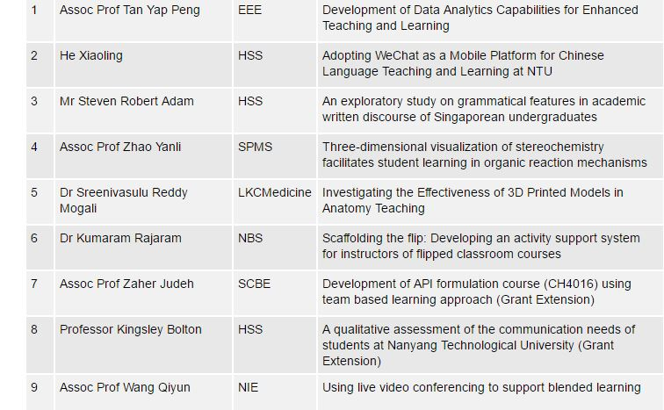
EdeX Teaching and Learning Project Grants
Research
and evaluation of learning and teaching
$600,000 total fund per year
Around 30 applications per year
Approx. 12-15 prohjects funded per year

Slide 31
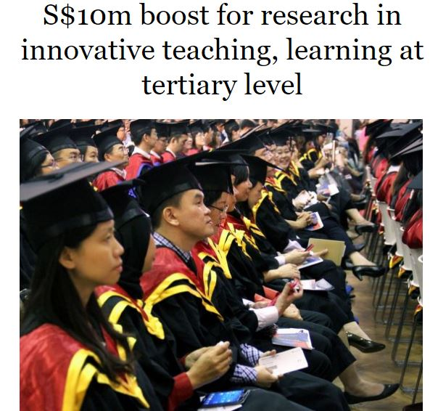

Ministry of Education Tertiary Research Funds
providing two levels of grants for teaching and learning projects.
In 2015, NTU received
5 of 11 grants awarded

Slide 32
Flipped classroom (dependent on spaces and technology)
Blended learning
Team-Based learning
https://www.youtube.com/watch?v=nrCl1YBTK_U
varied pedagogies

Slide 33
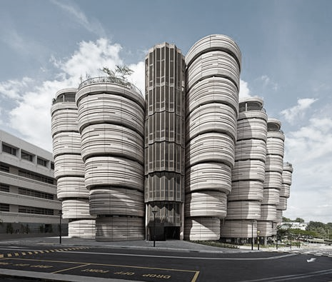
Questions

